Slide 1
The Goal of Economics
Economics is
the study of how to promote happiness
through the production, consumption and distribution
of goods and services
Economics Answer – promote economic efficiency
Produce at lowest possible cost → greatest possible output and lowest possible waste
Maximizes total market welfare (happiness)

Slide 2
How Best to Achieve this Goal
Method 1 – The Free Market Approach (Classical liberalism)
Allow people the maximum freedom to satisfy their self-interests anyway they like.
Consume what you like, produce what consumers want, behave however you like in pursuit of your own interests
Minimize the intervention of government
Have minimal concern about society’s inequalities

Slide 3
How Best to Achieve this Goal
Method 2 – The Liberal/Progressive Approach
Use the power of government to regulate economic outcomes
Social Democracy – maintain private ownership of businesses and the free market
Socialism – public ownership of means of production
Prevent the deleterious effects of unfettered self-interest (greed)
Promote altruistic behavior
Promote greater equality of economic outcomes

Slide 4
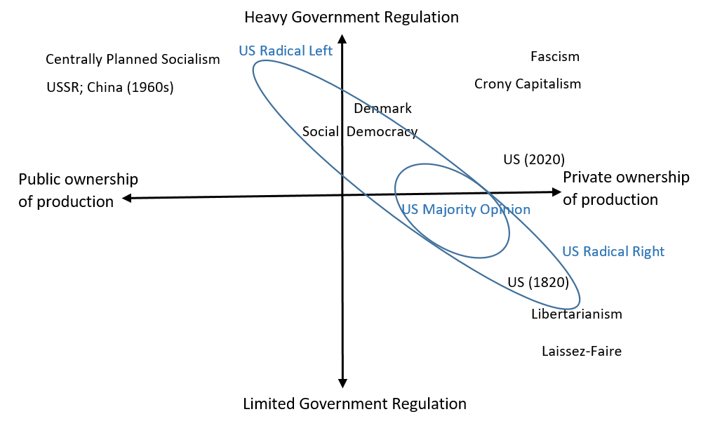
The Political/Economic Spectrum

Slide 5
The Political/Economic Spectrum
US Radical Left
Antagonistic towards capitalism and profit-seeking
Promotes altruism as motivating force
Promotes greater government regulation and Stete-owned enterprises (SOEs)
US Radical Right
Antagonistic towards almost all government regulation
Promotes self-interest as motivating force
Promotes conservatism – reversion to our “better past”
Eg. religious conservatism promoting US as a Christian nation

Slide 6
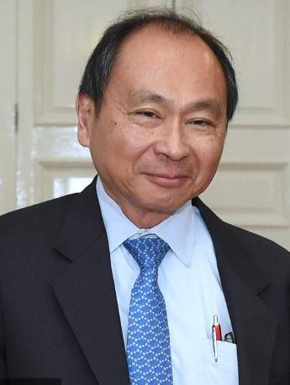
The Political/Economic Spectrum
Francis Fukuyama (1952 - ) Political scientist
Coined idea of “Getting to Denmark”
The Origins of Political Order: From prehuman times to the French Revolution (2011)
How does one create a stable, peaceful, prosperous, inclusive, and honest society?
In other words, how can all countries get to be like Denmark!

Slide 7
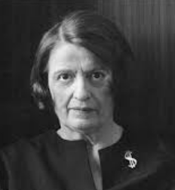
The Political/Economic Spectrum
Ayn Rand (1905 - 1982)
Fled USSR as adamant critic of communism and collectivism (government → theft and loss of freedom)
Author of Atlas Shrugged and The Fountainhead
Held in high regard by many on the US right including Rand Paul, Mark Cuban, Alan Greenspan, Peter Thiel, etc.

Slide 8
The Political/Economic Spectrum
Staunch promoter of individual self-interest
Believed that altruism is incompatible with freedom, with capitalism, and with individual rights
“There is nothing wrong with helping other people, … what I am fighting is the idea that charity is a moral duty and a primary virtue.”
This was a reaction to Auguste Comte’s notion that people should renounce self-interest and live only for the sake of others

Slide 9
The Political/Economic Spectrum
The Self-Interest vs Altruism Controversy
The US political left tends to see government as providing for more altruistic outcomes such as universal health care and social and economic equality
The US political right tends to see government as preventing individual self expression (self-interest) and thereby reducing freedom
Recall the Invisible Hand Controversy from Lecture 2

Slide 10
The Invisible Hand Controversy

Slide 11
The Invisible Hand Controversy

Slide 12
The Invisible Hand Controversy
Milton Friedman quotes:
The application of principles has to take account of circumstances
Adam Smith’s conception of how millions of people could coordinate their activities in mutually beneficial ways without central planning is every bit as valid today as it was then (definition of Invisible hand)

Slide 13
The Invisible Hand Controversy
Joseph Stiglitz quotes:
The idea that “unfettered markets always lead to efficient outcomes” is wrong. (definition of Invisible hand)
No one thinks that greed on the part of the bankers was good
The invisible hand is invisible because it’s not there

Slide 14
The Invisible Hand Controversy
Resolving the controversy means recognizing that they are applying different definitions of the invisible hand
Friedman’s is more general and traditional because it focuses on the remarkable truth that so many goods are available to us largely because profit-seeking firms prosper by satisfying consumer demands
Stiglitz’s is more ideological because he is saying that the idea that unfettered self-interest “always leads to good outcomes” does not match reality

Slide 15
The Invisible Hand Controversy
In this course, we highlighted how self-interest and production based on comparative advantage can lead to good outcomes but that these are only assured in the models when there are no market imperfections.
In Friedman’s terms, “under certain circumstances” means in cases when there are no imperfections or at least when the trading parties follow the “rules of the game” meaning while “engaging in open competition without deception or fraud”
These conditions are true for many of the day-to-day things we buy.

Slide 16
The Invisible Hand Controversy
Stiglitz refers to things like imperfect information, which is a type of market imperfection, to argue that the standard perfect competition models are not true representations of the real world
His argument that there is no invisible hand, really means that we shouldn’t assume that unfettered self-interest, as has been taught in many economics departments, always is best
He believes that often the circumstances are different … which I am quite sure Friedman would agree with

Slide 17
The Role of Government Controversy
Friedman differs from Stiglitz in the faith in government to correct market imperfections (MIs)
Friedman recognized that government can correct for MIs, but did not trust government to do so effectively
He also believed that government is petitioned too often by special interest groups and is just as likely to implement policies that cause further distortions, than policies that correct for MIs.
See his popular book and TV series “Free to Choose” for many simple examples of these issues

Slide 18
The Role of Government Controversy
Stiglitz recognizes that free markets work pretty well in many circumstances. He would not support socialism with government ownership of businesses
He understands Friedman’s concern about government failure, especially about pressure from special interests
However, he believes that government can provide an effective correction in the many instances of MIs
See his recent book “People, Power and Profits: Progressive Capitalism in an Age of Discontent”

Slide 19
Stiglitz vs Friedman
In my view, both Friedman and Stiglitz offer reasonable conceptions of a well-functioning society and that it is worthwhile to debate the pros and cons of their arguments.
However, recent policy discussions seem to have been captured by the more radical right and left.
Anyone agreeing with Stiglitz is labeled a socialist or communist
Anyone agreeing with Friedman is labeled an egoistic, antisocial, uncaring Randian

Slide 20
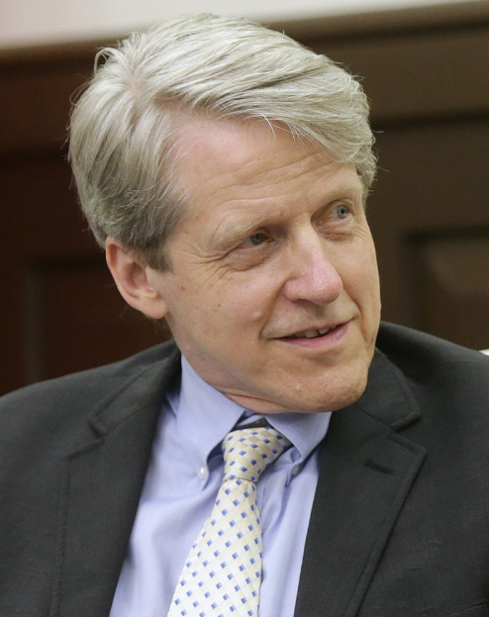
Robert Shiller (1946 - )
Nobel (2013) for work on financial markets
“Irrational Exuberance” (2000)
“Narrative Economics” (2019) discusses how these can go viral
Need not be true .. Just believable
Eg. Maximizing shareholder profit is evil
Eg. exports are good; imports are bad.

Slide 21
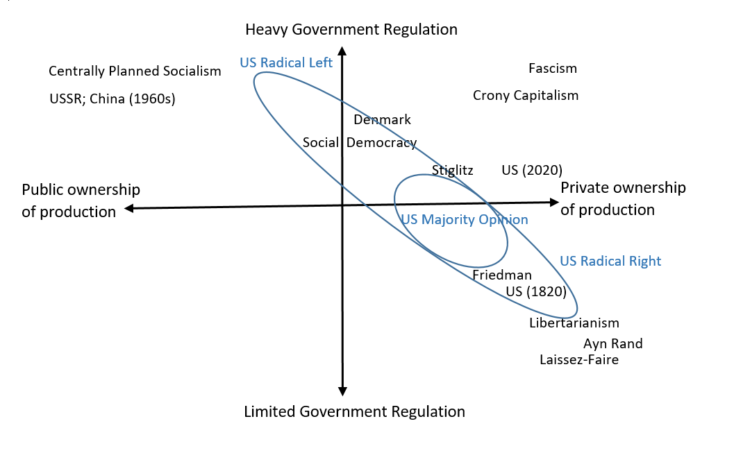
The Political/Economic Spectrum Again

Slide 22
Stiglitz vs Friedman
This course was designed to offer the pros and cons of both sides of the political/economic debate
Stiglitz and Friedman, as economists, both believe in the benefits of free markets
However, Stiglitz insists that we can’t allow unfettered self-interest to reign supreme because markets are often not perfectly competitive
Instead there are many market imperfections that demand attention

Slide 23
Stiglitz vs Friedman
Including the role of ethics in the functioning of the economic system can help us better understand the positions of Stiglitz and Friedman
This course highlighted why ethical behavior helps to promote economic efficiency – alternatively, why unethical behavior is bad for the economy
Unethical behavior → markets are imperfect or fail
Ethics implies constraints on self-interest

Slide 24
Ethical Economic Principles
What to Do
What Not to Do
Be Kind
Respect Property of others
Be Honest; Keep Promises
Market Freedom / Competition
Share information/ideas
Be a Good Neighbor
No violence or coercion
No theft
No Deception or fraud
No monopolizing or trade restraint
No secrecy or intellectual property
Minimize secondary harm (externalities)
Find more at ethicalecon.org

Slide 25
Methods to Promote Ethical Behavior
Public Methods
Private Methods
Establish a Judicial system
Threat of punishment prevents violence, theft, deception, fraud, etc
Provision of public goods
Local police, standing army, etc.
Regulations
Pollution control, Antitrust, common resource management
Religion; Parental Guidance; Community gossip
Promote Guilt, Shame, for violations. (self-domestication)
Promote Honor, Reputation, Respect for compliance
Use walls, locks, guards, etc.
Bargaining (Ostrom/Coase)

Slide 26
Stiglitz vs Friedman
Stiglitz and Friedman both believe that the institutions (public and private) that promote protection of private property, enforcement of contracts, prevention of fraud, correction for externalities, and the prevention of monopoly are good for economic efficiency
However, Stiglitz believes more in public (i.e., government) institutions to constrain behavior while Friedman believed more in private market outcomes
Friedman accepted some limited government but worried that government was a) inefficient and b) prone to special interest influence

Slide 27
Problems with Crony Capitalism

Slide 28
Problems with Crony Capitalism
Crony capitalism occurs when wealthy special interests, especially monopoly firms, use government to create regulations that make it easier to maintain monopoly profits.
Mancur Olson’s “Logic of Collective Action” explained why concentrated business interests are likely to prevail in democratic societies.

Slide 29
Problems with Crony Capitalism
Beneficial Government
Crony Capitalism Government
Provision of public goods
Judicial system
National defense
Local police/fire
Roads, parks
Environmental regulations
Common resource mgt.
Tariffs on imports
Intellectual property protections
Professional licensing
Agricultural/Energy subsidies
Labor Union Regulations
Price gouging laws
Public Schools
Tax code complications

Slide 30
Problems with Government Inefficiency
A government provides services demanded via the political system – not always the will of the majority
A government receives revenues by threat of punishment
You risk fines or prison if you don’t pay your taxes
Unlike businesses, governments do not need not provide valuable services (usually little competition)
Compare USPS to FedEx, UPS, etc.

Slide 31
Problems with Government Inefficiency
Governments tend to maximize spending
Little to no incentive to cut costs because that could reduce next years’ budget
“Incredibly, whenever I have proposed the theory that half of government workers could be cut, current and former federal employees I know have all agreed.” - Ronald Kessler

Slide 32
Ethics and Inequality
Our discussion of ethics in economics has almost ignored inequality. Why isn’t inequality the focus?
Because I think inequality is the consequence of all the other unethical behaviors
Theft/Deception/Fraud → winners take advantage of others → inequality
Monopolizing behavior → greater profits for firms → inequality
Negative externalities → polluters take advantage of others → inequality
Discrimination → advantages for some over others → inequality

Slide 33
Ethics and Inequality
There are two basic approaches to deal with economic inequality
1) Raise taxes on wealthy and redistribute to less wealthy
May promote resentment and counter-lobbying by the rich
May promote dependency by the poor
But this maintains the system that generates the inequalities
2) Eliminate the ability to create monopolies or to gain from others using theft, deception and fraud
Will require some method to reduce lobbying capabilities

Slide 34
Tale of Two Approaches
Left Leaning
Right Leaning
Maintain private ownership and mostly free markets
Control bad behavior with government regulations
Redistribute income from rich to poor
Intervene as needed to improve outcomes - eg. minimum wages, universal health care, etc
Maintain private ownership and mostly free markets
Control bad behavior with private mechanisms when possible
Leave people free to keep what they earn
Intervene as little as possible to assure maximum individual freedom

Slide 35
Tale of Two Approaches
Getting to Denmark is more in line with the left-leaning approach
Many in the US don’t want to go to Denmark!
One advantage in Denmark is a homogeneous population
The US in contrast is very diverse and becoming more polarized (or maybe that is just the narrative)
How can we satisfy a diverse population?

Slide 36
A Tale of Two Approaches
Maybe the problem is trying to achieve everything at the national level
This forces everyone to accept the same level of government, the same min wage law, the same gun policy, the same abortion law etc.
Maybe it could be better if individual US States created their own rules on most of these things
Don’t reject this just because it is a right-leaning position

Slide 37
A Tale of Two Approaches
Some States could duplicate Denmark; others Singapore;
Some might choose to emphasize Christian principles
The US is a common market ... Means that workers can move between states freely and can therefore choose which system to live under
Also, some states will do better than others and will inspire others to copy
In this way political competition for residents and companies will inspire some harmonization

Slide 38
A Tale of Two Approaches
Finally, if the federal government does little more than provide for the national defense, then lobbying becomes ineffective because they have little to give out
Lobbying would move to the state governments
But, this will be more costly (50 states to petition)
It might make the lobbying effort less effective and help solve that democracy problem

Slide 39
A Tale of Two Approaches
Keep open to ideas on both sides of the political economic spectrum
Be careful not to buy in to exaggerations (narratives) propagated by the right, left, or the special interests
Keep learning economics because there are so many more details we have not been able to consider
Good luck

Slide 40
Course Summary

Slide 41
Course Summary
Economic Terms to Remember
Adam Smith, division of labor, butcher-brewer-baker, pin factory, invisible hand, positive-normative economics, Joseph Stiglitz, Milton Friedman, Capitalism-Socialism, deduction-induction, assumption v. implication, consequential v. inconsequential, simplify v. reflect reality, utility, diminishing marginal utility, indifference curve, Edgeworth box, terms of trade, marginal rate of substitution, MRS=ToT, pareto optimal, efficiency, mutually voluntary exchange, cooperation, property rights, honesty, intermediation, labor productivity, unit-labor requirement, absolute advantage, opportunity cost, comparative advantage, David Ricardo, specialization, demand curve, substitutes, complements, normal-inferior goods, expected price, expected income, price elasticity of demand, elastic-inelastic demand, income elasticity, cross-price elasticity, consumer surplus (welfare), profit, total revenue, total cost, economic vs accounting profit, marginal product of labor, increasing-decreasing-constant returns to scale, marginal cost, average cost, fixed cost, variable cost, average fixed cost, average variable cost, economies-diseconomies of scale, monopoly, intellectual property rights, price discrimination, marginal revenue, MR=MC, duopoly, oligopoly, antitrust, game theory, dominant strategy, prisoner’s dilemma, perfect competition, P=MC, short-long run, firm entry/exit, supply curve, input prices, technology, equilibrium price-quantity, price elasticity of supply, producer surplus, competition, market welfare, taxes, tax revenue, ceteris paribus, deadweight losses, production-consumption efficiency loss, imports, exports, tariff, price ceiling, price gouging, price floor, minimum wage, monopsony, price support, logic of collective action, Mancur Olson, concentrated benefits, dispersed losses, special interests, market imperfections, public goods, nonexcludable-nonrival, common resources, tragedy of the commons, Elinor Ostrom, negative-positive production-consumption externalities, marginal social benefits-costs, pecuniary-nonpecuniary, Ronald Coase, Benevolent Dictator, Roving Bandit, Stationary Bandit. Ayn Rand, altruism, Francis Fukuyama, “Getting to Denmark” Robert Shiller, Narrative Economics,

